Slide 1



KaggleX- Showcase
OCTOBER 2023
Notes:
Recommending picking out he most interesting and important parts from your documentation.

Slide 2
Personal Background
Hi, I’m Kayenga Campos.
I am a highly engaged professional in the field of data science with 4 years of experience addressing challenges related to data processing and interpretation. I have experience in various projects and international collaborations, such as the Statistics Without Borders initiative of the American Statistical Association, IEEE SIGHT, and Etica.AI, an organization dedicated to the interdisciplinary study of ethics in artificial intelligence. I also write for Towards AI, where I share my expertise in topics rooted in statistical modeling within the context of machine learning.
My projects encompass a range of challenging areas, with a focus on complex tasks involving natural language processing (NLP), machine learning, deep learning, data visualization, and computer vision. Through the application of these skills, I am able to develop technical solutions for a wide range of problems."

Slide 3
REAL TIME MANUFACTURING MONITORING WITH COMPUTER VISION
Kayenga Campos

Slide 4
Project Definition
Topic: Real Time Manufacturing Monitoring with Computer Vision
Methodology: Receives two videos (one from the bottle factory production line and another from the restricted access area), sends the videos to a YOLOv8 model. The model detects objects in the videos (bottles and people) and triggers certain commands in the system based on what it can see.
Why this topic? The monitoring of the bottle production line with object detection, alarm system for restricted areas, and tracking of essential substance levels is essential to optimize production, maintain worker safety, and ensure product quality, resulting in a more efficient and competitive industrial environment.
Topics Learnt: Websockets, Transfer of Learning, Image Processing, Perfomatic Dash Plotly Apps.

Slide 5
Project Details
WEBSOCKET
VIDEOS
YOLO V8
DASH COMPONENTS
PERSON CONTAINER
BOTTLE
CONTAINER

Slide 6
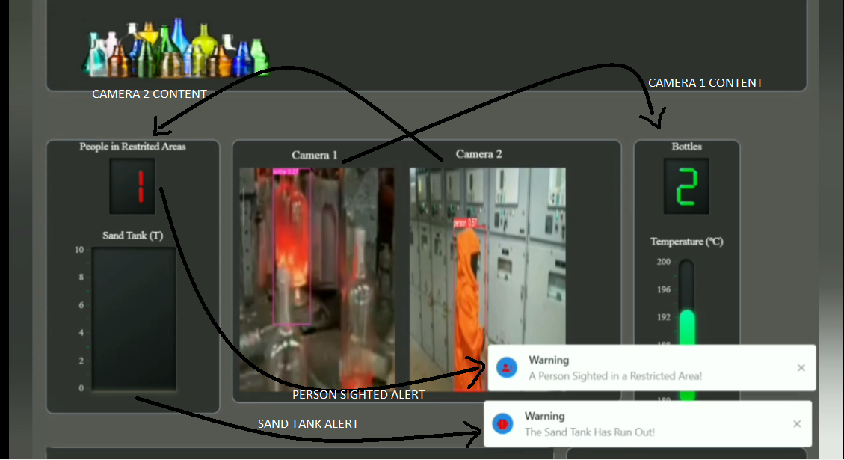
Project Example

Slide 7
Project Links
Project github repo: https://github.com/Kissabi/GeniusVR
Yolo V8 docs by ultralytics: https://docs.ultralytics.com/
Dash plotly docs: https://dash.plotly.com/

